Slide 3
Location Based Business Recommendation Using Spatial Demand
Great use for enterprenures to get a perfect area and number of customers who need for the service .
Predicting the match winner
https://blog.coast.ai/this-is-how-i-used-machine-learning-to-accurately-predict-villanova-to-win-the-2016-march-madness-ba5c074f1583#.e6xllp64p
Madhurika Ganiger

Slide 5
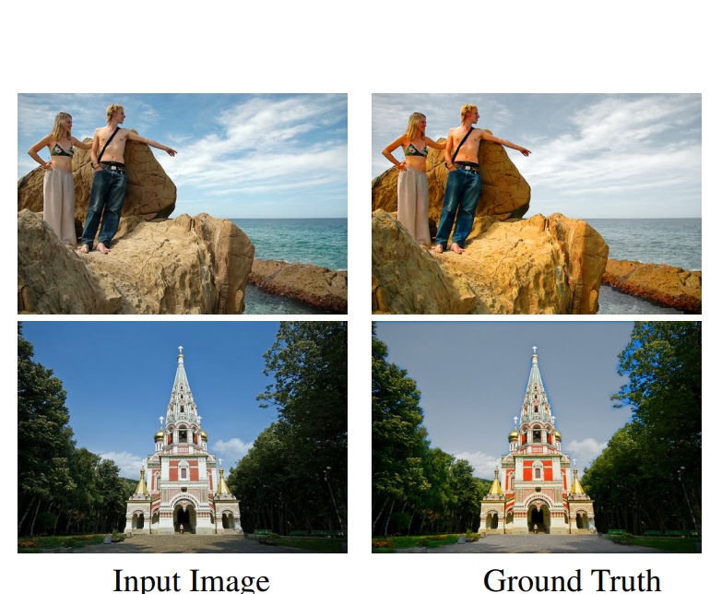
AUTOMATIC IMAGE STYLIZATION USING DEEP FULLY CONVOLUTIONAL NETWORKS : Conventional automatic photo adjustment has difficulty in representing complex color transforms between images before and after adjustment. Most of them merely model global color transforms without considering local semantic contexts. Aim : Given a set of exemplar image pairs, each representing a photo before and after pixel-level color and tone adjustments following a particular style, we wish to learn a computational model that can automatically adjust a novel input photo in the same style.
Abhishek rao

